Slide 1


Microsoft Academic Graph
Z 604 Big Data Analytics for web & text
Final Project
Team members
Arun Ram​
Ganesh Nagarajan​
Neha Bisht​
Siddharth Jayasankar​
Nishant Shah
Under the Supervision of professor Xiaozhong Liu

Slide 2

Research Question
Given the title and keywords of a paper, predict useful papers for citation.​

Slide 3

Background
Huge amount of research means numerous papers on similar topics
Searching all papers is impossible
Providing accurate citations is a tough ask
Uncertainty in choosing accurate citations

Slide 4
Data Set Description
Affiliations
Affiliation name
Authors
Author name
Conference
Short name (abbreviation)
Full name
ConferenceInstances
Short name (abbreviation)
Full name
Location
FieldsOfStudy
Field of study name
Journals
Journal name
Papers
Paper ID
Normalized paper title
Paper publish year
PaperAuthorAffiliations
Original affiliation name
Normalized affiliation name
Author sequence number
PaperKeywords
Paper ID
Keyword name
Field of study ID mapped to keyword
PaperReferences
Paper ID
Paper reference ID
PaperUrls
Paper ID
URL

Slide 5
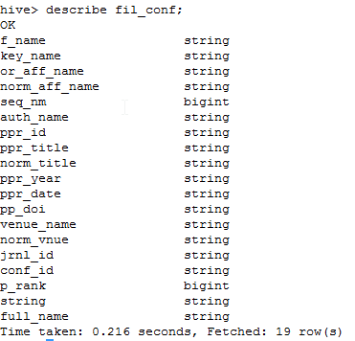

Dataset Summary
Hive Table Summary
Subset of all papers on Information Retrieval & Machine Learning
Hive Row Counts
~100,000 Papers
~200,000 Relationships

Slide 6






Tools
Indexing and similarity measure
Loading the entire data
Page Rank
Recommendation system by collaborative filtering
Sub-setting based on Field of study
Evaluation

Slide 7
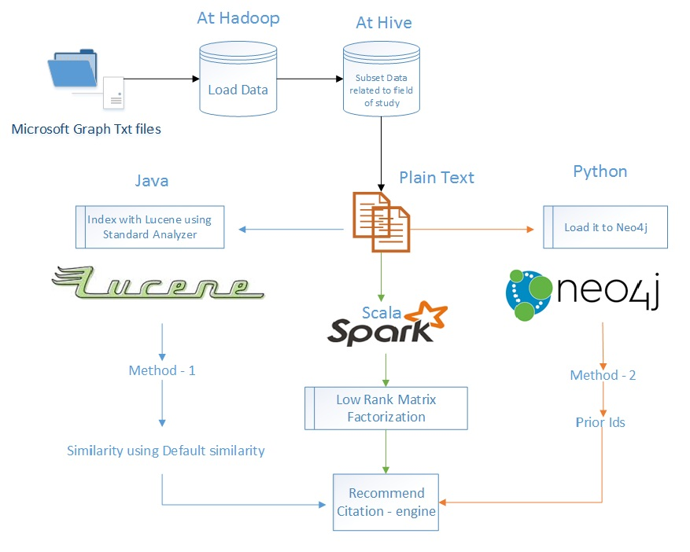
Data indexation method

Slide 8
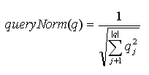



Paper title similarity using Lucene
Indexing using Standard Analyzer
Remove stop words
Tokenize title
PaperID , Title , Keywords were indexed as text fields.
Title similarity using Default Similarity.

Slide 9
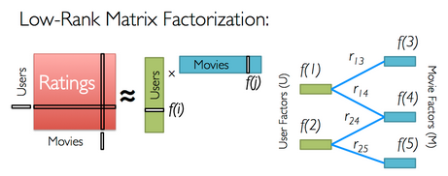
Collaborative Filtering : Low Rank Matrix Factorization
Based on Low-Rank Matrix Factorization
Analogy : Citing paper is user, Cited Paper is product
Suggest Similar product to the user
Uses Spark’s mllib. Best model MSE : 0.06

Slide 10
Collaborative Filtering - Citations as Context
In order to give context for a recommendation, we ask the user to provide few citations that they plan to use for their paper
Eg, Paper A Cites 10 papers, we give any three papers as context citation to the algorithm
Matrix Factorization now uses this as implicit feedbacks and imputes other values
This can be compared to asking the user their initial preference for predicting similar movies

Slide 11
Overcoming “Cold Start” Problem
Neo4j can be leveraged to give initial “guesses” for giving context to the recommendation
Currently Cypher query for “Top 10 in-degrees” is a good initial guess, Followed by their most in-degrees in their neighbors, then hop by one
Allows guided selection for users with “no idea where to start”

Slide 12
Collaborative Filtering with BOW similarity

Slide 13
Collaborative filtering with Informed Prior

Slide 14
Sample Citation Recommendations
Paper: an ensemble of grapheme and phoneme for machine transliteration (language)
english to korean statistical transliteration for information retrieval
automatic identification and back transliteration of foreign words for information retrieval
automatic transliteration and back transliteration by decision tree learning
japanese english cross language information retrieval exploration of query translation and transliteration
an english to korean transliteration model of extended markov window
an ensemble of transliteration models for information retrieval
mining the web to create a language model for mapping between english names and phrases and Japanese
backward transliteration for thai document retrieval
uci repository of machine learning databases
generating phonetic cognates to handle named entities in english chinese cross language spoken document retrieval

Slide 15
Sample Citation Recommendations
Paper: who is who in the end recognizing pianists by their final ritardandi(music)
automatic identification of music performers with learning ensembles
relational ibl in music with a new structural similarity measure
in search of the horowitz factor
discovering simple rules in complex data a meta learning algorithm and some surprising musical discoveries
roc graphs notes and practical considerations for researchers
modeling expressive music performance in jazz
data mining an overview from a database perspective
automatic recognition of famous artists by machine
the retrieval of document images a brief survey
the strength of weak learnability

Slide 16
Sample Citation Recommendations
Paper: new machine learning methods for prediction of protein secondary structures
automated discovery of structural signatures of protein fold and function
protein secondary structure prediction using logic based machine learning
drug design by machine learning the use of inductive logic programming to model the structure activity relationships of trimethoprim analogues binding to dihydrofolate reductase
structure activity relationships derived by machine learning the use of atoms and their bond connectivities to predict mutagenicity by inductive logic programming
parallel and sequential algorithms for data mining using inductive logic
the effect of relational background knowledge on learning of protein three dimensional fold signatures
Foundations of inductive logic programming
inductive logic programming
theory completion using inverse entailment
probabilistic inductive logic programming

Slide 17
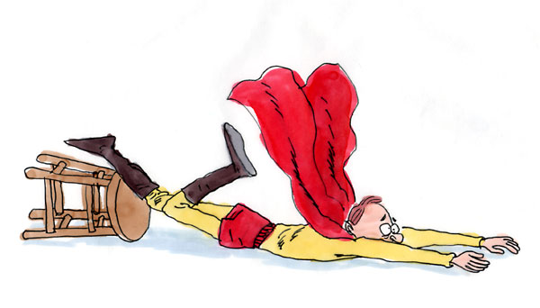
Limitation
Predictive analysis is done for fields of Information Retrieval and Machine Learning only.
We were able to provide useful citations but not the same as ground truth
There is room for improvement of accuracy.

Slide 18

Future work
Integrate page-rank for increasing accuracy.
Include paper abstract and full paper text

Slide 19

Conclusion
The title of the paper provides limited information to predict accurate citations.
The more specific the context citations are the better the output

Slide 20

Questions ?

Slide 21


